Slide 1
MeetCute;)
Iteration 2
Notes:
Hi everyone this is team-2, <intro teammates>

Slide 2
Outline
Hello & Road Map - DS + GT
Code update - Everyone
Design Patterns - BB
Schema Design - GT
Key Algorithms - DS
Testing - DS
Generating Documentation - GT
Quality metrics - EN

Slide 3
Road Map
20%
45%
View ^LandingPage ^Message
^Profile
^Discover
Control ^Log in/out ^send Message
^editing profile
Model ^Initialized all tables
Milestone Profile+Discover system done.^ Pass Acceptance^
Message System Done^
Notes:
After assiduous hard-working, We finally achieved almost 50% percent of our work. Gautam: bs

Slide 4
Code Updates & Demo
Iteration 2
Notes:
Demo Profile Page editing, and Message Page Sending msg

Slide 5
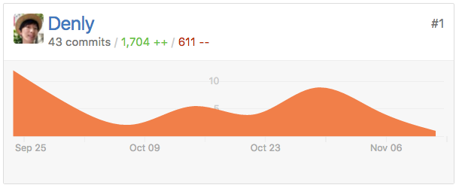
Daniel’s
Did during this iter: Message Page and MessageRoom pop-out’s model, view, controller. Tutoring, Testing.
Todo: Router specify userId “/message/<userId>”
Notes:
During the iteration 2 I work on Message Page, including the controller, view component, model. Proudced 43 commits and almost 2k lines of code
I’ll show

Slide 6
Becky’s
Configure Profile page to show logged-in user
Configure Discover page to show other users
Cosmetic changes to both pages
User introduction is editable on Profile page

Slide 7
Adiba’s
Worked on Discover Page to re-size the Profile card and committed in git.
Implemented the testing scenario for Popout Message card.
Worked on SDD.
To-Do:
Testing tutorial
More test cases
Notes:
Plz don’t change it

Slide 8
Gautam’s
- Worked on ‘Messaging’ story
- Designing MongoDB collections
- Wrote documentation for codebase so far
- Worked on methods and dependencies for SDDD
Currently working on: Optimizing schema design; incorporate emojis in messaging;

Slide 9
Ian’s
Quality Assurance Update/ReWrite
SDD Coordination
Selenium Tutorial for Integration Testing
To Do’s
Finalize Quality Assurance
Review SPPP / SDD / STD
Push Test code via Github

Slide 10
Gabriel’s
-Updated SDDD w/ project files & explanation
- Fix application logout button defect
- Update to create test users on startup
TODO:
-Security documentation/presentation
-Moar code changes

Slide 11
Design Patterns
Iteration 2

Slide 12
MVC / MVVM
Meteor.js framework is flexible enough to allow the software architecture to implement the patterns they choose.
Our implementation uses hybrid of the Model - View - Controller and Model-View-ViewModel patterns.
Views are comprised of nested Components that define the content of the pages
Views can retrieve models directly from the database.
Most events are handled in the View
however any Events resulting in a model update are handled by the Controller.

Slide 13
Schema Design
Iteration 2

Slide 14
Schema Design in MongoDB
MongoDB is essentially ‘schema-less’
MongoDB uses JSON documents to store records.
Reduces amount of logic needed to build into application layer.
JSON documents easily parsed by frontend and backend Javascript.
Two types of data modelling
Embedding
Referencing

Slide 15
message collection
profile collection
{
_id : BSON Object
text : String
fromId : String
toId : String
ImgId : BSON Object
createdAt : Date
}
{
_id : BSON Object
name : String
dob : Date
Intro : String
}
messageRoom collection
Image collection
{
_id : BSON Object
newMId : BSON Object
numMsg : Integer
UId1 : BSON Object
UId2 : BSON Object
createdAt : Date
updatedAt : Date
}
{
_id : BSON Object
userId : String
serviceId : String
service : String
type : String
createdAt : Date
}

Slide 16
Key Algorithms
Iteration 2

Slide 17
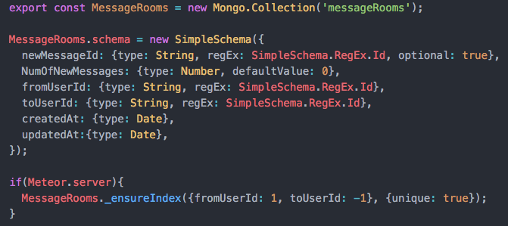
Code review (Key Alg.)
[Model]
define attributes of MessageRoom.
Using 2 users As primary key
Notes:
Plz don’t change it

Slide 18
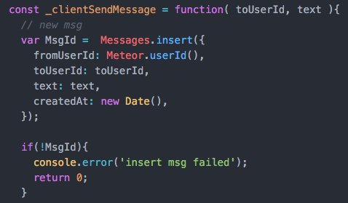
Code review
[Controller]
Insert a Message
Notes:
Plz don’t change it

Slide 19
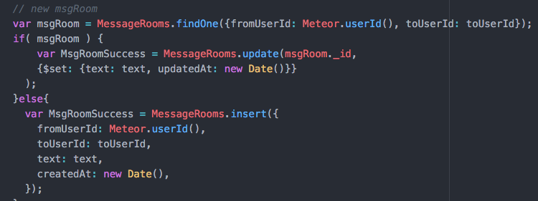
Code review
[Controller]
Insert or update a MsgRoom
Notes:
Plz don’t change it

Slide 20
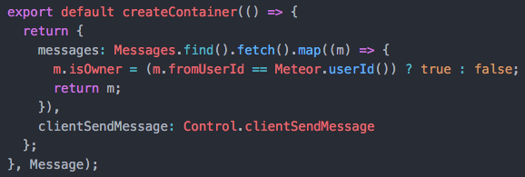
Code review
[Controller->View]
Feed data and controller to View
Notes:
Plz don’t change it

Slide 21
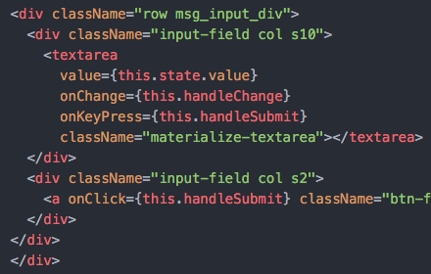
Code review
[View]
In input field, apply controller and inner logics to send msg
Notes:
Plz don’t change it

Slide 22
Testing
Iteration 2

Slide 23
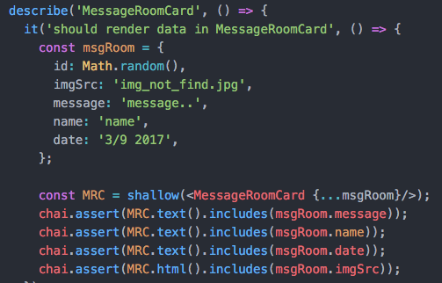
Code review
[Unit Test]
Throw data into a react component See it show or not.
Notes:
Plz don’t change it

Slide 24

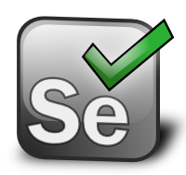
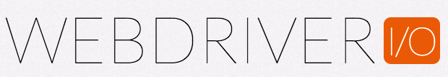
Acceptance testing
Acceptance testing is the process of taking an unmodified version of our application and testing it from the “outside” to make sure it behaves in a way we expect. Typically if an app passes acceptance tests, we have done our job properly from a product perspective.
Selenium and WebdriverIO
->Chimp

Slide 25
Generating Documentation
Iteration 2

Slide 26
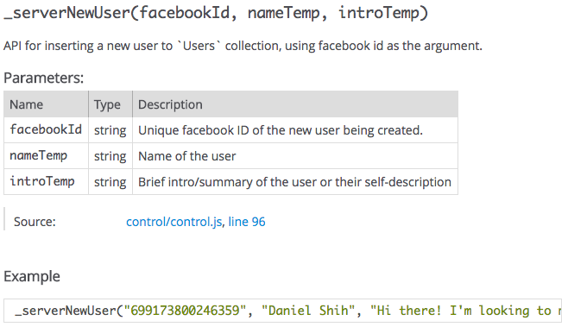

Slide 27
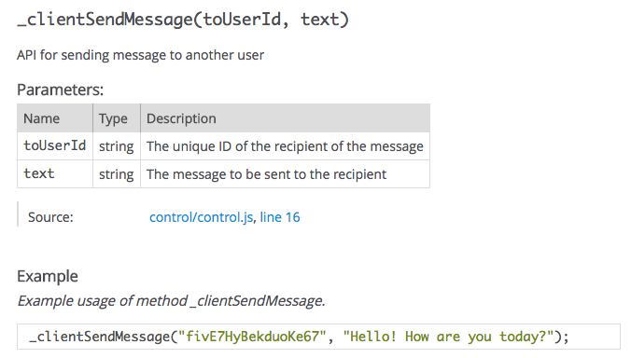

Slide 28
Quality metrics
Iteration 2

Slide 29
Metric Table
Iteration Phase | Processes Metrics | Category | Person Hours
2 | SPPP (Updated) | Documentation | 3
2 | Learning Selenium Integration Testing | Tutorials | 5
2 | SDD (Update with APP specifications) | Documentation | 8
2 | Discover Page (User Discover Cards) | Coding | 12
2 | Profile Page (Bio / Profile Card) | Coding | 12
2 | Messaging (Single Thread / API) | Coding | 17
2 | Tutorials (Misc) | Tutorials | 5

